Slide 1
STUDENT MANAGEMENT SYSTEM (SMS)
Reg no:243114351023
EMMANUEL NOEL KAKWERA

Slide 2
INTRODUCTION
Student Management System (SMS) is designed to help in managing student academic records easily and efficiently.
The aim was to create a small, simple, and trustworthy program to manage student information.

Slide 3
WHY THIS SYSTEM WAS NEEDED
To handle problems like:
Errors like miss recording of data,
Data loss if physical records are damaged,
difficulty in updating or tracking academic progress over time.

Slide 4
SYSTEM OVERVIEW
The Student Management System is a Python desktop app made with Tkinter. It works offline and saves student and module data using CSV files.
The system is designed to be:
Lightweight – no extra software needed
Easy to Use – simple forms and buttons
Efficient – fast to open, save, and manage data

Slide 5
SYSTEM REQUIREMENTS
To run the system smoothly:
Operating System: Windows, Linux, or macOS
Needs: Python 3.x installed
libraries: Tkinter and CSV (already included with Python)
No internet or extra downloads needed – perfect for offline use

Slide 6
FEATURES
Add Student: You can quickly add new students by filling in simple fields like ID, name, age, course, and phone number.
View Students: View the entire list of students and their modules in a clean, table-like format.
Manage Modules: Add, update, or delete modules assigned to students.

Slide 7
CONTINUE……
GPA Calculation: The system can instantly calculate the student's GPA based on a 4.0 grading scale.
Course Filter: If you want to see students enrolled in a specific course, you can easily filter the list.
Error Handling: Whenever the user inputs wrong data or misses a field, the system provides helpful popup alerts.

Slide 8
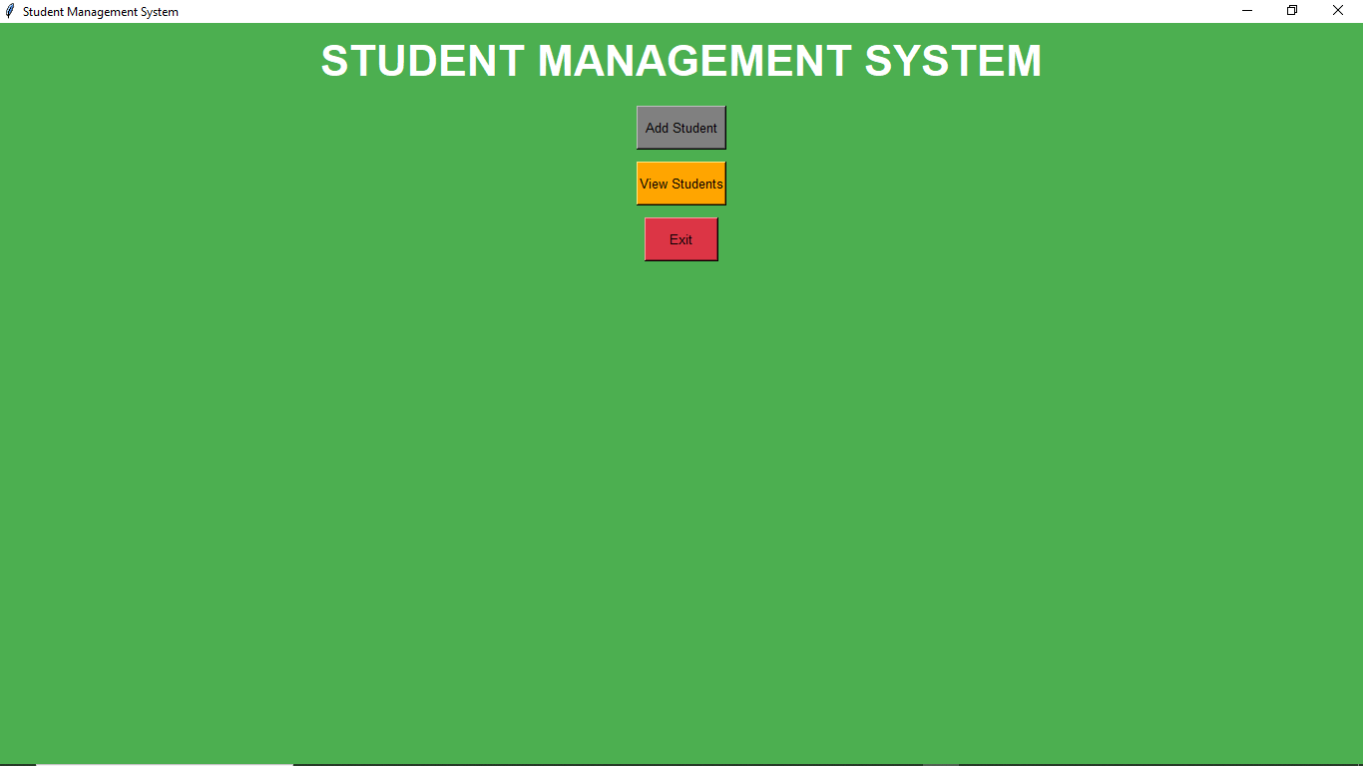
Home Dashboard: From here, users can either add a new student or view existing students.

Slide 9
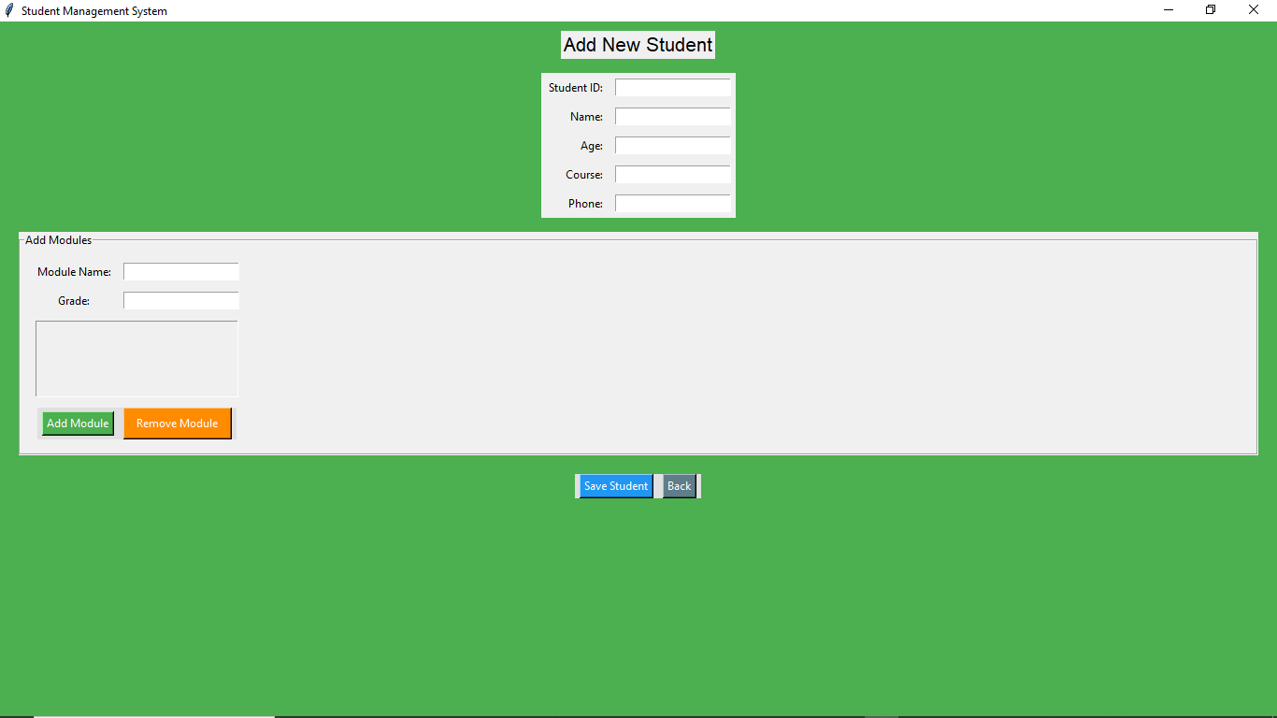
Add Student Form: Fields for entering student details and modules

Slide 10
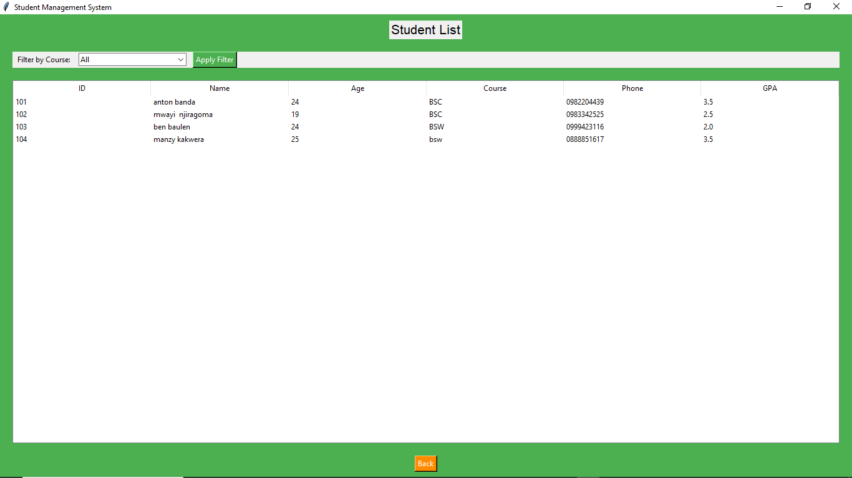
Student Records Table: Shows all the saved students and their modules.

Slide 11
DATA STORAGE
The system saves data in two CSV files:
students.csv – holds student details (ID, name, age, course, phone)
modules.csv – stores modules and grades linked to each student

Slide 12
SYSTEM ARCHITECTURE
The system has three main parts:
Frontend: Users interact through Tkinter forms and buttons
Logic: Python handles input, validation, and calculations
Storage: Data is saved in CSV files

Slide 13
ERROR HANDLING
The system helps users fix mistakes by showing helpful messages:
Missing fields? → Error popup
Invalid grades? → Warning if not between 0–100
File issues? → Protected using try-except in the backend

Slide 14
FUTURE ENHANCEMENTS
1.Search functionality: Search students by name, ID, or course.
2. User authentication: Secure access with login features.
3. Sorting options: Organize students by GPA, course, or name.
4. CSV import/export: Backup and restore data easily.
5. UI enhancements: Modernize design with improved styling and layouts.

Slide 15
CONCLUSION
The Student Management System is a simple yet powerful tool that streamlines student record management, ensuring accuracy and efficiency while saving time, all without requiring internet access.

Slide 16
THANK YOU ALL!!!

